Slide 1
FUELS
A combustible substance which on proper burning in air liberates huge amount of heat, that can be used economically for domestic and industrial purposes
e.g. coke, coal, charcoal, petroleum diesel etc

Slide 2
Where We Get Oil?
The world's top five crude oil-producing countries are:
Saudi Arabia
Russia
United States
Iran
China

Slide 3
Composition of petroleum
C : 80-87%
H : 15%
S,N,O : 1%

Slide 4
Composition of Crude Oil

Slide 5

Fractional Distillation of Petroleum
Petroleum can be separated into different fractions by fractional distillation.
This separation can take place because petroleum is a mixture of substances with different boiling points.

Slide 6
Conditions for Oil Refining
Petroleum is heated to 360°C in the absence of air in a furnace to vaporize it before fractional distillation.

Slide 7
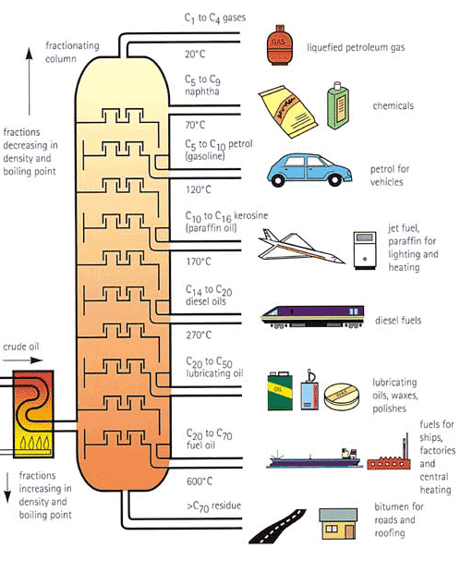

Slide 8
Petroleum delivered from well field
Water washing to remove impurities
Distillation to separate by boiling point ranges
Conversion reactions to alter molecular structures
Mixing to obtain maximum commercial characteristics

Slide 9
CLASSIFICATION
Fuels
Primary or natural Secondary or derived
Solid liquid Gaseous
Wood crude oil Natural gas
Coal
Dung
solid liquid gaseous
coke tar coal gas
charcoal kerosene water gas
diesel oil gas
Petrol bio gas
LPG

Slide 10
CHARACTERISTICS OF A GOOD FUEL 1. High Calorific value 2. Low moisture contents 3. Moderate ignition temperature 4. Low ash content 5. No harmful combustion product formation 6. Moderate rate of combustion 7. low cost 8. Easy to transport

Slide 11
Comparision between solid, liquid and gaseous fuels
Properties | Solid fuels | Liquid fuels | Gaseous fuels
Price | Cheap and easily available | Costly | Costly except natural gas
Transport and storage | easy | Transported easily though pipelines but must be stored in closed containers carefully | Transported through pipelines and are stored in leak proof tanks

Slide 12
Combustion | slow | quick | Very fast
Fire hazards | Less risk | Greater risk | Even greater than liquid fuels
Smoke and ash | Always produced and reduces calorific value | Ash is not produced but smoke is produced | Neither ash nor smoke is produced
Calorific value | least | higher | Highest

Slide 13
CALORIFIC VALUE 1g compound + O₂ CO₂ +H₂O, ∆H= ? Here, ∆H = calorific value UNITS 1. Calorie: for 1g of water by 1ºC 1calorie = 4.184 Joule = 4.185 x 10⁷ ergs 2. K.Calorie: for 1 kg of water by 1ºC 3. British Thermal Unit (B.Th.U.): for 1 pound of water by 1ºF 4. Centigrade heat unit (C.H.U.): for 1 pound by 1ºC

Slide 14
GROSS OR HIGHER CALORIFIC VALUE (HCV) Heat evolved when a unit quantity of a fuel is completely burnt and the products of combustion are allowed to cool at room temperature. A + O₂ CO₂ + H₂O_{(v)} , ∆H₁=x H₂O_{(v)} H₂O_{(l)} , ∆H₂ = y (y = latent heat of steam) So, HCV = Total ∆H = x+ y

Slide 15
LOWER OR NET CALORIFIC VALUE (LCV or NCV) Heat evolved when a unit quantity of a fuel is completely burnt and the products of combustion are allowed to escape at room temperature. A + O₂ CO₂ + H₂O_{(v)} , ∆H₁=x LCV = x = HCV – latent heat of water vapors formed = HCV – 0.09 x H x 587 cal/g (where, H = % of hydrogen in the fuel)

Slide 16
Differences between Gross and Net calorific value
S.No. | GCV | NCV
1 | The amount of heat released when unit quantity of fuel is burnt completely and the products of combustion are allowed to cool at room temperature. | The amount of heat released when unit quantity of fuel is burnt completely and the products of combustion are allowed to escape at room temp.
2 | Latent heat of condensation of steam is included | Latent heat of condensation of steam is not included
3 | It is also known as Higher Calorific Value | It is also known as Lower Calorific Value
4 | Having more value than NCV | Having lesser value than GCV

Slide 17
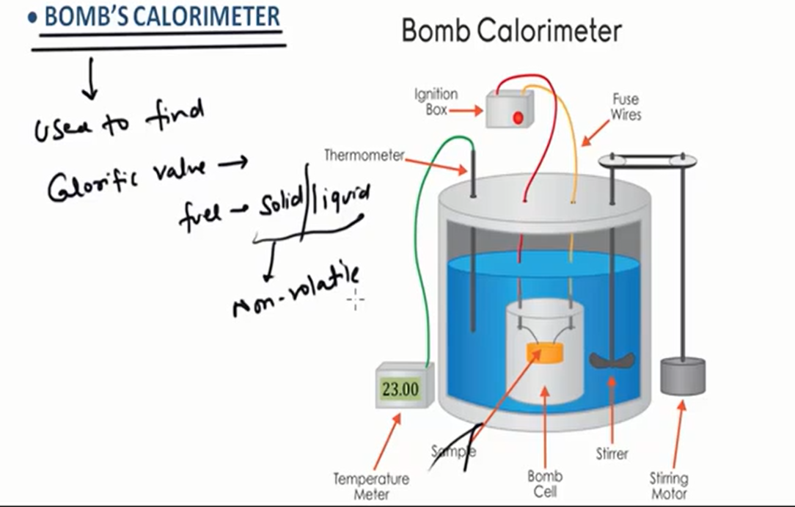

Slide 18
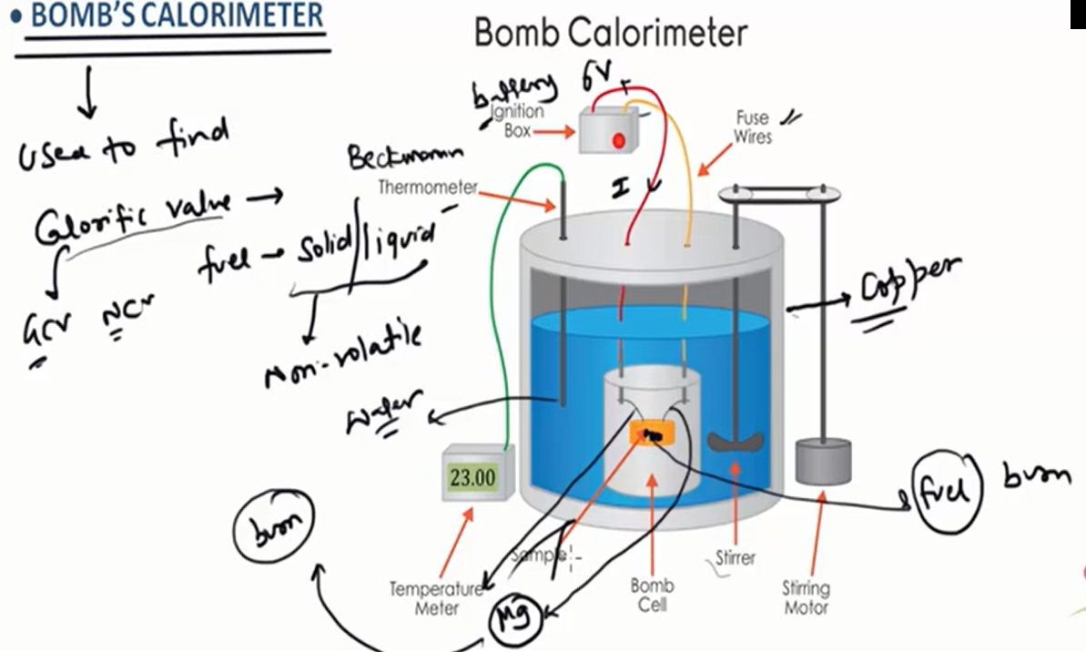

Slide 19
CALCULATION mass of fuel taken in calorimeter = m g mass of water taken in calorimeter=Wg water equivalent of calorimeter bomb, thermometer, stirrer etc = w g Initial temp. of water in calorometer = t₁ final temp. of water in calorimeter = t₂ higher calorific value = HCV heat liberated by burning of fuel = m x HCV heat gained by water, calorimeter etc = (W+w)(t₂-t₁) heat liberated = heat gained m x HCV = (W + w)(t₂-t₁) HCV = (W+w)(t₂-t₁) cal/g or kcal/kg m

Slide 20
Let H be the % of hydrogen in the fuel,then
LCV = HCV – 0.09H x 587 cal/g or kcal/kg
Corrections
(i) Fuse wire correction (C_{F}) : should be subtracted.
(ii) Acid correction (C_{A}) : should be subtracted.
(iii) Cooling correction (C_{C}) : should be added.
So, HCV = (W + w)(t₂-t₁+C_{C})-(C_{A}+C_{F}) cal/g
m

Slide 21
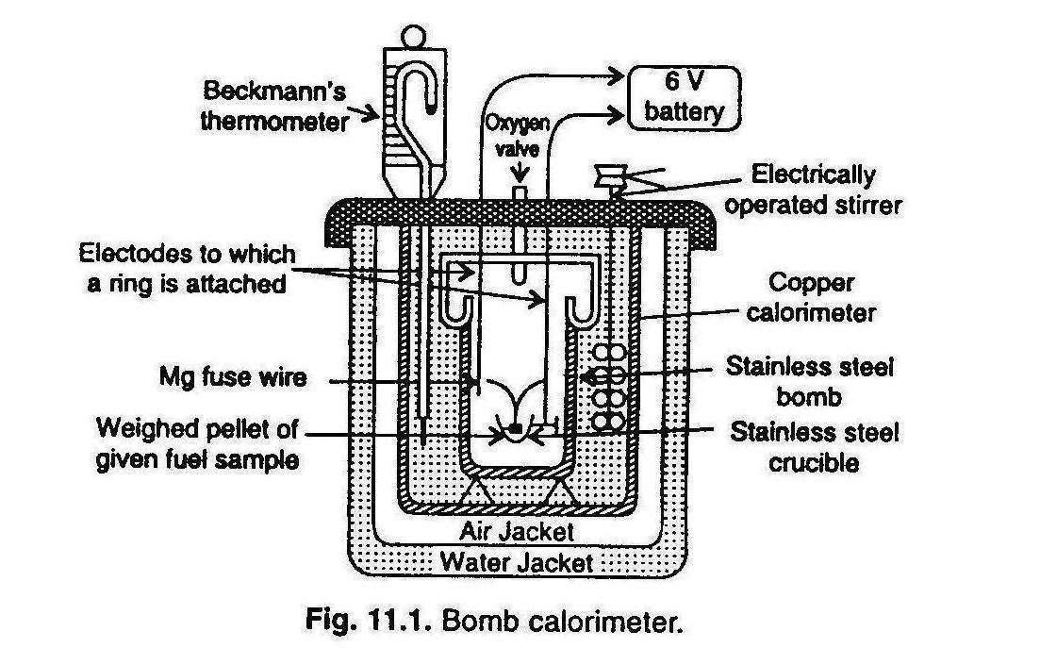
BOMB CALORIMETER

Slide 22
COAL SAMPLE ANALYSIS
Proximate analysis
Ultimate analysis

Slide 23
ANALYSIS OF COAL SAMPLE
Coal is a highly carbonaceous matter that has been formed from fossilized remains of plants under suitable conditions.
ANALYSIS- 2 types
1. PROXIMATE ANALYSIS - includes the determination of moisture, volatile matter, ash and fixed carbon
Moisture: at 110ºC for an hour
% of moisture = Loss in wt. x 100
wt of coal sample

Slide 24
(ii) Volatile matter : at 925+/- 25ºC for 7 minutes
% of volatile matter = Loss of wt due to removal of volatile matter x 100
wt of coal sample taken
(iii) Ash content: at 700-750ºC for half an hour
% of ash = wt of ash x 100
wt of coal sample taken
(iv) Fixed carbon = 100- % of (moisture + ash + volatile matter)
SIGNIFICANCE:
Higher % of fixed carbon Higher calorific value better fuel

Slide 25
ULTIMATE ANALYSIS OF COAL
Includes the estimation of % of elements in the fuel
(i)Determination of C & H
C + O₂ CO₂
H₂ + O₂ H₂O
2KOH + CO₂ K₂CO₃ + H₂O
CaCl₂ + 7H₂O CaCl₂.7H₂O

Slide 26
% of C =Increase in the wt of KOH tube x 12 x 100
Wt of coal sample taken x 44
% of H = Increase in the wt of CaCl₂ tube x 2 x 100
Wt of coal sample taken x 18

Slide 27
(ii) Determination of N: Kjeldahl method
Fuel(W g) + H₂SO₄ (NH₄)₂SO₄
(NH₄)₂SO₄ + NaOH NH₃ +Na₂SO₄ + H₂O
Known amount
of HCl
NH₃ is neutralised Excess HCl
(Titrated against alkali)

Slide 28
Mass of fuel = W g
Volume of acid used to neutralize NH₃ = V ml
Normality of HCl = N
Eq. of HCl = Eq. of NH₃ = Eq. of N
w = NVx14
1000
% of N = Wt of N₂ x 100 = 1.4 NV
Wt of coal sample taken(1g) W

Slide 29
DETERMINATION OF S:
S+ O₂ SO₂
SO₂ + H₂O H₂SO₄
% of S = wt of BaSO₄ formed x 32 x 100
wt of coal sample x 233
(iv) DETERMINATION OF ASH:
by proximate analysis

Slide 30
(V) DETERMINATION OF O:
% of O = 100 - % of (C + H + N + S + ash)

Slide 31
OCTANE NUMBER
O.N. signifies the ignition quality of gasoline in automobile engines.
For grading gasoline(Petrol)
Isooctane = 100
n-heptane = 0
The % of isooctane present in the mixture of isooctane and n-heptane which has the same knocking property as the fuel itself.
More the octane number, better the fuel efficiency.

Slide 32
Reasons for opting the blend of iso-octane & n-heptane:
The different hydrocarbon in gasoline:
Straight chain paraffin
Iso-paraffins
Naphthenes
Aromatics
For the same Carbon No; straight chain paraffin have lowest octane No.
Branched chain paraffin (isomers), Naphthenes have higher octane No.
Aromatic have high O.N. but their content is being restricted due to their carcinogenic nature.

Slide 33
Octane numbers of few hydrocarbons:
Carbon | Hydrocarbon | Octane No.
C₆ – Straight chain | n- Hexane | 28.8
C₆ – Isomer | Methyl Pentane | 73.4
C₆ – Isomer | Dimethyl Butane | 91.8
C₆ – Napthenes | Cyclohexane | 83
C₆ – Aromatic | Benzene | 98
C₇ – Paraffin | n - Heptane | 0
C₇ – Isomer | Dimethyl Pentane | 88
C₈ – Isomer | Iso – Octane | 100
C₇ – Aromatics | Toluene | 107

Slide 34
Methods to increase octane number:
By adding the antiknocking agent: e.g. TEL (about 1.0-3.0 ml /gallon petrol) along with some ethylene dibromide.
By isomerisation
By alkylation
By aromatisation
By Cracking

Slide 35
Conversion Reactions
THERMAL
CRACK
CATALYTIC
ALKYLATION
COMBINE
POLYMERIZATION
REFORMIING
Dehydrogenation
Dehydroisomerization
Isomerization
Dehydrocyclization
Hydrocracking
REARRANGE
ISOMERIZATION

Slide 36
Catalytic Reforming – Conversion Reactions

Slide 37
Cracking (Pyrolysis).
CH₃-CH₃ CH₂=CH₂ + H₂
CH₃CH₂CH₃ CH₃CH=CH₂ + H₂
CH₂=CH₂ + CH₄
CH₃CH₂CH₂CH₃ CH₃CH₂CH=CH₂ + H₂
CH₃CH=CH₂ + CH₄
CH₃-CH₃ + CH₂=CH₂
Isomerisation.
CH₃CH₂CH₂CH₃ (CH₃)₃CH
(CH₃)₂CHCH₂CH₂CH₃ (CH₃)₂CHCH(CH₃)₂ + (CH₃)₃C-CH₂CH₃
CH₃ (CH₂)₆CH₃ (CH₃)₂CH(CH₂)₄CH₃
(ON = -19) (ON = 100)
∆/-nce of air
∆/-nce of air
∆/-nce of air
AlCl₃ / HCl / ∆
AlCl₃ / HCl / ∆
AlCl₃ / HCl / ∆

Slide 38
Aromatisation.
C₆H₁₄ C₆H₆
C₇H₁₆ C₆H₅CH₃
C₈H₁₈ C₆H₅-CH₂CH₃ + o-xylene + m-xylene + p-xylene
* Catalysts: Cr₂O₃/Al₂O₃ or CrO₃/Pt.
Oxidation.
With Cu at 200°C & 100 atm. : Alcohols.
With MnO at 200°C : Carboxylic acids.
With Mn(OAc)₂ : Carboxylic acids.
With alkaline KMnO₄ : Tertiary alcohols.
Catalyst / 600°C
Catalyst / 600°C
Catalyst / 600°C

Slide 39
CETANE NUMBER
For grading diesel oil
Normal paraffin's have highest cetane no. followed by naphthenes, isoparaffins, olefins and aromatics.
For grading diesel oil.
Hexadecane (cetane) = 100
α- methyl naphthalene = 0
The % of cetane present in the mixture of cetane and α-methyl naphthalene which has the same ignition property as the fuel itself.
More the cetane number, better the fuel efficiency.

Slide 40
FLASH POINT
The flash point of a volatile liquid is the lowest temperature at which it can vaporise to form an ignitable mixture in air.
At the flash point, the vapour may cease to burn when the source of ignition is removed.
Or
The minimum temperature, at which the sample gives sufficient vapours, which forms an ignition mixture with air, giving a flash when a flame is applied to it, is called flash point.

Slide 41
FLASH POINT
The flash point of a volatile liquid is the lowest temperature at which it can vaporise to form an ignitable mixture in air.
At the flash point, the vapour may cease to burn when the source of ignition is removed.
Or
The minimum temperature, at which the sample gives sufficient vapours, which forms an ignition mixture with air, giving a flash when a flame is applied to it, is called flash point.

Slide 42
CHARACTERISTICS OF SATURATED HYDROCARBONS (ALKANES)
General formula: C_{n}H_{2n+2} (n is a whole number).
All the four valencies satisfied with hydrogen/carbon/any other atom.
Consist of only carbon and hydrogen bonded by single covalent bonds.
Range from Methane (one Carbon atom in the molecule) upto molecules containing 60+ C atoms i.e., a range of molecular weights from 16 upto 850 +.
Straight- or branched-chain molecules.
Rotation about single covalent bonds
occurs freely. The energy barrier is small.
The position of hydrogen atoms relative to
one is thus constantly changing.

Slide 43
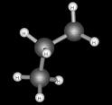
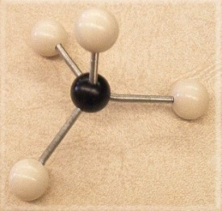
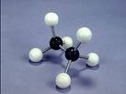
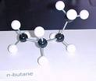
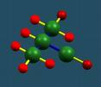
Methane Ethane Propane
n-Butane iso-Butane
Skeletal structure of only carbon atoms
C₁ – C₄ n-alkanes are all gases.
Methane main component of natural gas.
Propane and butane often stored as compressed gases.

Slide 44
PREPARATION OF ALKANES
By the reduction of unsaturated hydrocarbons.
RCH=CH₂ + H₂ RCH₂CH₃
By Wurtz reaction.
2RCH₂X + 2Na RCH₂CH₂R
From Grignard Reagent.
RMgX +H₂O → RH + Mg(X)OH
Kolbe’s electrolytic method.
2RCOONa 2RCOO⁻ + 2Na⁺
(At anode) (At cathode)
2Na⁺ 2Na 2NaOH + H₂
2RCOO⁻ 2RCOO˙ 2R˙ R-R
Ni
Ether / ∆
Current
+2e⁻
H₂O
-2e⁻
-2CO₂
Coupling

Slide 45
From sodium salt of carboxylic acids.
RCOOH + NaOH → RCOONa + H₂O
RCOONa RH + Na₂CO₃
By the reduction of alkyl halides.
RI RH + I₂
RI RH + I₂
By the hydroboration of alkenes.
RCH=CH₂ RCH₂CH₃
Corey-House Synthesis.
RCl + 2Li RLi + LiCl
2RLi + CuCl → R₂CuLi + LiCl
R₂CuLi RR’ + RCu + LiCl
Soda lime
HI, P
HI, P
B₂H₆ / THF / Propionic acid (reflux)
Ether
R’X

Slide 46
PHYSICAL PROPERTIES OF ALKANES
Lower members gases, in-between liquids and higher waxy solids.
Non-polar in nature, less denser than water.
Immiscible with water making two layers but soluble in organic solvents.
Regular increases in boiling and melting points with molecular weight.
Specific gravity increases with increase in molecular weight.

Slide 47
CHEMICAL PROPERTIES OF ALKANES
Combustion.
C_{n}H_{2n+2} + (3n+1/2) O₂ → (n+1) H₂O + nCO₂
Free radical substitution reactions.
Nitration.
RCH₂R’ + HNO₃ RNO₂ + R’CH₂NO₂ + R’NO₂ + RCH₂NO₂ + RCH(NO₂)R’
Halogenation.
CH₄ CH₃Cl CH₂Cl₂ CHCl₃ CCl₄
Sulfonation.
RH + H₂SO₄ → RSO₃H + H₂O
450°C
Cl₂/UV light
Cl₂/UV light
Cl₂/UV light
Cl₂/UV light

Slide 48
CHARACTERISTICS OF
UNSATURATED HYDROCARBONS
General formula C_{n}H_{2n}.
Presence of double or triple bonds in between different carbon atoms.
Straight or branched chain molecules.
sp² hybridized.
Trigonal planar in shape.

Slide 49
PREPARATION OF ALKENES
By the dehydration of alcohols.
C₂H₅OH CH₂=CH₂ + H₂O
CH₃CH₂CH₂OH CH₃CH=CH₂ + H₂O
(CH₃)₃COH (CH₃)₂C=CH₂
(*Elimination according to Saytzeff’s rule).
By the dehydrohalogenation of alkenes.
CH₃CH₂Br CH₂=CH₂ + Br⁻ + H₂O
By the dehalogenation of vicinal dihalides.
CH₂Br-CH₂Br CH₂=CH₂ + ZnBr₂
H₂SO₄ / 160°C
H₂SO₄ / 180°C
H₂SO₄ / 85°C
Alc. KOH / ∆
Zn / CH₃COOH

Slide 50
By Cracking.
CH₃-CH₂-CH₂-CH₃ CH₄ + CH₂=CH-CH₃
CH₂=CH₂ + CH₃CH₃
By the controlled hydrogenation of alkynes.
RC≡CH + H₂ RCH=CH₂
∆
Pd-CaCO₃ / quinoline

Slide 51
PHYSICAL PROPERTIES OF ALKENES
First three members: gases at ordinary temperature; next fourteen liquids; rest solids.
Slightly soluble in water; freely soluble in organic solvents.
M.P., B.P. and specific gravity rise with increase in molecular weight.

Slide 52
1. ADDITION REACTIONS
Addendum
Alkyl Halides
Alkyl hydrogen Sulfate
Alcohols
Dihaloalkanes

Slide 53
Mechanism of Addition reactions on C=C
Ionic mechanism. Always Electrophilic addition
*The electrophile is a Lewis acid, i.e. it accepts a pair of electrons,
while nucleophile is a Lewis base, its donated a pair of electrons.
Step I: Attack of electrophile
The Slow Step is the Rate Determining Step
Step II: Attack of nucleophilic part of the addendum.

Slide 54
Anti-Markovnikov’s Rule / Peroxide Effect / Khharasch Effect: Addition reversed in the +nce of peroxides.
CH₃CH₂CH₂Br
CH₃-CH=CH₂ + HBr
CH₃CHBrCH₃
(*Proceeds via free radical mechanism).
Markovnikov’s Rule:
+ve part of the addendum goes to that carbon atom which already contains the maximum number of H atoms.
Unsymmetrical Alkene
Peroxide
No peroxide

Slide 55
(i) Addition of sulfuric acid

Slide 56
(ii) Addition of Halogen acids
2-Bromopropane
(Major product)
2º Carbocation prefered
1-Bromopropane (Minor product)
1º Carbocation
3º > 2º > 1º
Carbocation stability

Slide 57
(iii) Bromination
Formation of cyclic intermediate.
Back-side nucleophilic attack of bromide ion: opening of three membered ring.
*Stereospecific Product

Slide 58
(v) Addition of Hypohalous acid.
CH₂=CH₂ + HOX → HOCH₂-CH₂X
Halohydrin

Slide 59
(iv) With Ozone: Aldehydes and ketones.
R₂C=CHR R₂CO + RCHO
RCH=CHR’ RCOOH + R’COOH
3. Combustion.
CH₂=CH₂ + 3O₂ → 2CO₂ + 2H₂O
4. Polymerisation:
O₃ / Zn-H₂O
O₃ / H₂O₂
Large molecules containing many identical repeating units (100- 1000000).
Condensation Polymerisation: A by-product is eliminated along with the formation of polymer.
Addition polymer: Monomer simply add together to give the polymer without elimination of by-product.

Slide 61
CHARACTERISTICS OF ALKYNES
General formula C_{n}H_{2n-2}.
Presence of triple bond, containing one σ and two Π-bond.
The two p-bonds are perpendicular to each other and form a cylinder of negative charge about the axis of the bond ---------- No bond rotation about triple bond.
sp-orbitals contain 50% s- and 50% p-character.
The carbon-carbon bond is 1.2Aº shorter than C=C, which is 1.3Aº. C-H bond is also shorter than ethene, which is shorter than ethane.
The bonding electrons reside closer to the C-nucleus, and so are held more tightly.

Slide 62
PREPARATION OF ALKYNES
From calcium carbide:
CaC₂ + 2H₂O → HC≡CH + Ca(OH)₂
2. From dehydrohalogenation of vicinal dihalides:
CH₃CHBrCH₂Br + 2KOH → CH₃C≡CH + 2KBr + 2H₂O
RCH₂CHBrCH₂Br + 2NaNH₂ RCH₂C≡CH + 2NaBr + 2NH₃
(*KOH helps in isomerisation).
3. From ketones.
RCOCH₂R’ RC(X₂)CH₂R’ RC≡CR’ + 2HCl
4. By the displacement reaction.
RC≡CH RC≡C⁻Na⁺ RC≡CR’ + NaX
150°C
PX₅
Alc. KOH
NaNH₂
R’X

Slide 63
PHYSICAL PROPERTIES OF ALKYNES
First three members gases; next eight liquids; higher solids.
Slightly soluble in water; soluble in organic solvents.
B.P., M.P., density increase with increase in molecular weight.

Slide 64
CHEMICAL PROPERTIES OF ALKYNES
1. Addition reactions:
Reduction.
RC≡CH RCH=CH₂ RCH₂CH3
R R
RC≡CR C=C
H H
cis-alkene
R H
C=C
H R
trans-alkene
Alkynes are more reactive in halogenation reactions than alkenes.
H₂, Ni
H₂, Ni
H₂, Pd / BaSO₄
Quinoline
Na / NH₃

Slide 65
(ii) Addition of Halogens.
RC≡CR RCX=CXR RCX₂-CX₂R
(iii) Addition of Hydrogen Halides.
RC≡CH RCX=CH₂ RCX₂CH₃
2. Addition of HCN.
HC≡CH + HCN CH₂=CHCN
X₂ / CCl₄
X₂ / CCl₄
HX (g)
HX (g)
CuCl in HCl

Slide 66
4. Reaction with metals.
RC≡CH + NaNH₂ → RC≡C⁻Na⁺ + NH₃
RC≡C⁻Na⁺ + R’Br → RC≡CR’ + NaBr
RC≡CH + AgNO₃ + NH₄OH → RC≡CAg + H₂O + NH₄NO₃
2RC≡CH + Cu₂Cl₂ + 2NH₄OH → 2RC≡CCu + 2H₂O + 2NH₄Cl
RC≡CH + CH₃MgBr → RC≡CMgBr + CH₄

Slide 67
ALICYCLIC COMPOUNDS / NAPHTHENES
Cyclic and aliphatic in nature.
General formula C_{n}H_{2n} (n is a whole number usually from 1 to 20).
Isomeric with alkenes.
Ring structures are monocyclic to Polycyclic combinations.
Cyclopropane
Cyclobutane
Cyclopentane

Slide 68

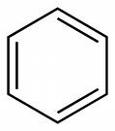

PREPARATION OF CYCLOALKANES
By the reaction of dihalogen derivatives with sodium.
XCH₂-CH₂-CH₂X + 2Na → + 2NaX
2. By the photolysis of cyclic ketones.
+ CO
3. By Clemmensen or Wolf-Kishner reduction.
4. By the reduction of aromatic hydrocarbons.
hυ
Zn -Hg/ HCl
NH₂NH₂ / KOH
H₂ / Ni

Slide 69
PHYSICAL PROPERTIES
First two members gases, rest liquids.
M.P., B.P. increase with increase in molecular weight.
Insoluble in water, soluble in organic solvents.

Slide 70
CHEMICAL PROPERTIES OF CYCLOALKANES
Ring Opening reactions.
CH₃CH₂CH₃
BrCH₂CH₂CH₂Br
CH₃CH₂CH₂Br
CH₃CH₂CH₃
2. Substitution reactions. X
+ X₂ + HX
H₂, Pd / C
Br₂
HBr
H₂, Ni , ∆
hυ

Slide 71
AROMATICS
General formula: C₆H₅-Y (Y is a longer, straight molecule that connects to the benzene ring).
Ringed structures with one or more rings.
High carbon content: burns with smoky flame.
Cyclic.
Conjugation.
Planar structure.
Resonance.
Follow Huckel’s rule [Cyclic cloud of π-electrons with presence of (4n+2) π- electrons].
Show saturated behaviour.

Slide 72
PREPARATION OF AROMATIC HYDROCARBONS
By heating the sodium salt of aromatic carboxylic acid in the +nce of soda-lime.
C₆H₅COONa C₆H₆ + Na₂CO₃
By Friedel-Craft’s alkylation.
C₆H₆ + RX C₆H₅R
Aromatization.
Soda-lime / ∆
AlCl₃ / reflux
Catalyst / 600°C
C₆H₁₄ C₆H₆
C₇H₁₆ C₆H₅CH₃
C₈H₁₈ C₆H₅-CH₂CH₃ + o-xylene + m-xylene + p-xylene
Catalyst / 600°C
Catalyst / 600°C
* Catalysts: Cr₂O₃/Al₂O₃ or CrO₃/Pt.

Slide 73
CHEMICAL PROPERTIES OF AROMATIC HYDROCARBONS
Reactivity is different to other unsaturated compounds- Substitution rather than Addition is favoured.
Substitution reactions: Electrophilic substitution.
C₆H₆ + E-Nu → C₆H₅-E + HNu
Halogenation.
C₆H₆ + X₂ C₆H₅X + HX
(ii) Nitration.
C₆H₆ C₆H₅NO₂
(iii) Sulfonation.
C₆H₆ C₆H₅SO₃H
anhy. AlCl₃
Conc. HNO₃ / Conc. H₂SO₄
Conc. H₂SO₄

Slide 74
(iv) Friedel-Craft;s reaction.
Alkylation.
C₆H₆ + RX C₆H₅R + HX
B. Acylation.
C₆H₆ + RCOX C₆H₅COR + HX
C₆H₆ + (RCO)₂O C₆H₅COR + RCOOH
anhy. AlCl₃
anhy. AlCl₃
anhy. AlCl₃

Slide 75
1k.cal = 1000Cal = 3.968 B.Th.U. = 2.2 C.H.U.

